Slide 1
CS478 Term Project
Convex Hull
Mehmet Feyyaz Küçük - 22003550
Deniz Çelik - 22003271

Slide 2

IMPLEMENTATION DETAILS
JavaScript for algorithms,
For rendering, CanvasRenderingContext2D of HTML canvas is used.

Slide 3
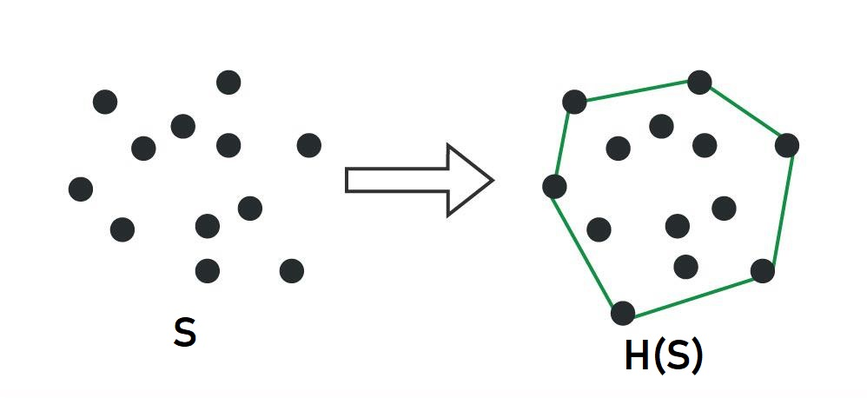
Convex Hull
Given a set of points S, the convex hull H(S) is the smallest convex polygon that includes all points of S in its interior or boundary.

Slide 4
Extreme PoInts
A point p of a convex set S is called an extreme point if for no two points a, b, a, bS, such that p lies on the open segment ab. Extreme points of S will be the vertices of the convex hull of S.

Slide 5
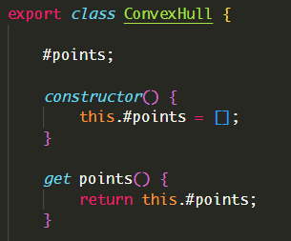
CONVEX HULL REPRESENTATION
We stored convex hulls as list of points in our application, in a counter-clockwise ordered fashion.

Slide 6
Graham’s Scan

Slide 7
Graham’s Scan
Sort the set of points according to a pivotal point based on the angle it makes with respect to x-axis.
Find the extreme points E of S => H(E) = H(S)
Vertices of the convex hull will be ordered in a counter-clockwise fashion.

Slide 8
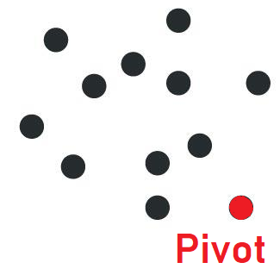
Graham’s Scan AlgorIthm
Find the pivot point of the set S, this is the point with lowest x and lowest y coordinate, (y coordinate prioritized).

Slide 9
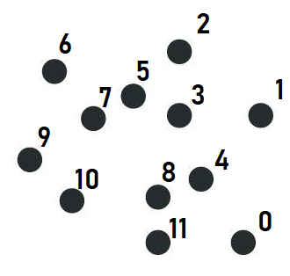
Graham’s Scan AlgorIthm
2. Sort the set of points based on the angle they make with the pivot point with respect to x-axis, (pivot element should be the first point in the set).

Slide 10
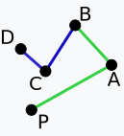
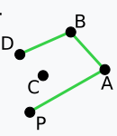
Graham’s Scan AlgorIthm
3. Starting from the 3rd point, for each point in the set, until the current point with the two preceding points make a left turn, we remove the point directly preceding the current point. This will give us the complete hull.
BCA makes a right turn,
remove C.
ABD makes a left turn,
go to next point.

Slide 11
Graham’s Scan AnImatIon

Slide 12
JarvIs’s March

Slide 13
JarvIs’s March
Rather than extreme points follow the edges along the convex hull.
Principle idea is: the terminus of an edge will be the origin of the next edge.
Vertices of the convex hull will be ordered in a counter-clockwise fashion.

Slide 14
JarvIs’S March AlgorIthm
Find the pivot point of the set S, this is the point with highest x and lowest y coordinate, (y coordinate prioritized).

Slide 15
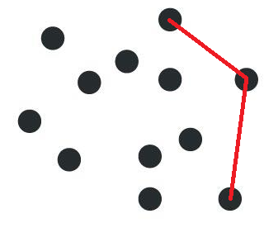
JarvIs’S March AlgorIthm
2. Starting from the pivot point, for each point, iterate through the set of points to find the terminus point, which makes the lowest angle with the current point with respect to x-axis until you reach the point with the highest y coordinate. This is called marching up.
March up

Slide 16
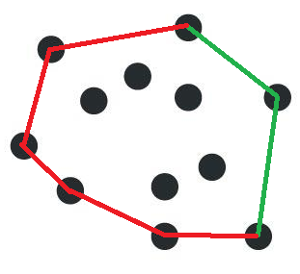
JarvIs’S March AlgorIthm
3. Repeat step 2, but this time find the lowest angle with respect to negative x-axis, until you reach the pivot point. This is called marching down.
March down

Slide 17
JarvIs’s March AnIMatIon

Slide 18
QuIckHull

Slide 19
QuIckHull
The principle behind this algorithm is to recursively finding farthest point.

Slide 20
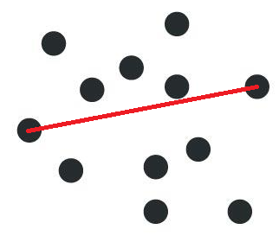
QuIckHull AlgorIthm
Find the two points in the set with the lowest and highest x coordinates. Draw a line between them.

Slide 21
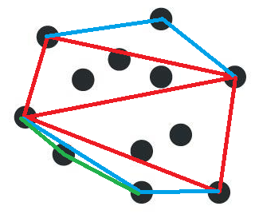
QuIckHull AlgorIthm
2. Find the orthogonal farthest point from the line recursively until the a farthest point cannot be found which is the base case.
Red: 1st recursion
Blue: 2nd recursion
Green: 3rd recursion

Slide 22
QuIckHull AnIMatIon

Slide 23
MergeHull

Slide 24
MergeHull
Sort the points in the set in increasing x coordinate values.
Divide the set into two equal parts.
For the base case use Graham’s Scan to construct the hull.
Merge the left and right hulls, (trickiest part).

Slide 25
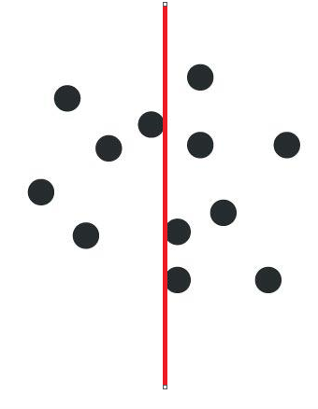
MergeHull AlgorIthm
Sort the points in increasing x coordinate and divide the set into two subsets.

Slide 26
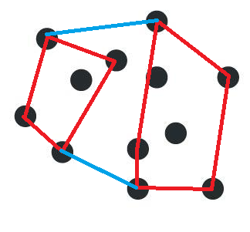
MergeHull AlgorIthm
2. Construct the base hulls using Graham’s Scan and merge left and right subsets by finding the upper and lower tangent between the left and right hulls.
upper tangent
lower tangent

Slide 27
MergeHull AnIMatIon

Slide 28
GRAHAM’S SCAN COMPLEXITY ANALYSIS
Algorithm Steps:
Finding the pivot → O(n)
Sorting based on the angle → O(n logn)
Calculating the edges → O(n)
Time Complexity → O(n logn)

Slide 29
JARVIS’ MARCH COMPLEXITY ANALYSIS
Algorithm Steps:
Finding the pivot → O(n)
Marching up and down → O(nK) (where K is the number of points on the convex hull)
Time Complexity → O(nK)

Slide 30
QUICKHULL COMPLEXITY ANALYSIS
Algorithm Steps:
Finding the baseline → O(n)
Finding the distal points and drawing edges → T(n) = 2T(n/2) + O(n)
Time Complexity → T(n) = O(n logn)

Slide 31
MERGEHULL COMPLEXITY ANALYSIS
Algorithm Steps:
Sorting, dividing the points and making small hulls with the points → O(n logn)
Merging the hulls → T(n) = 2T(n/2) + O(n)
Time Complexity → T(n) = O(n logn)

Slide 32
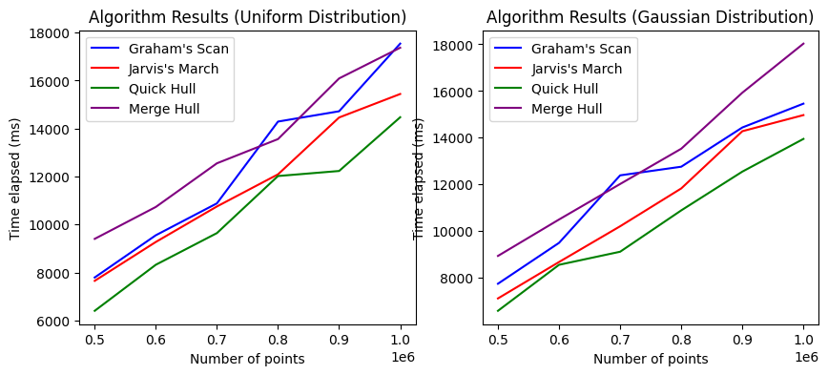
RUNTIME ANALYSIS

Slide 33
THANK YOU FOR LISTENING!

